Slide 1

Paid Leave Options in the Age of COVID-19
Marilyn Watkins,
Economic Opportunity Institute
April 16, 2020
opportunityinstitute.org

Slide 2
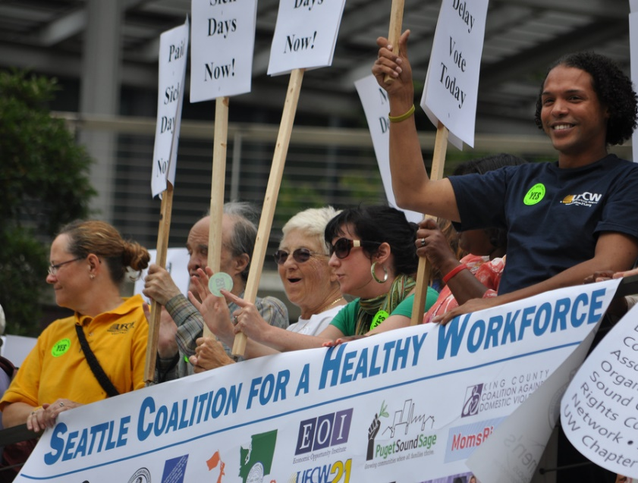
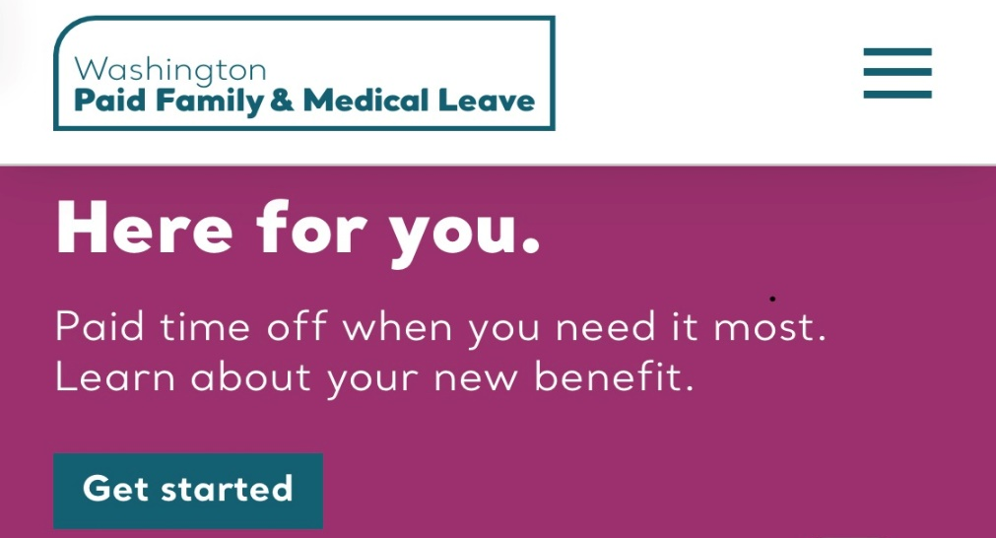
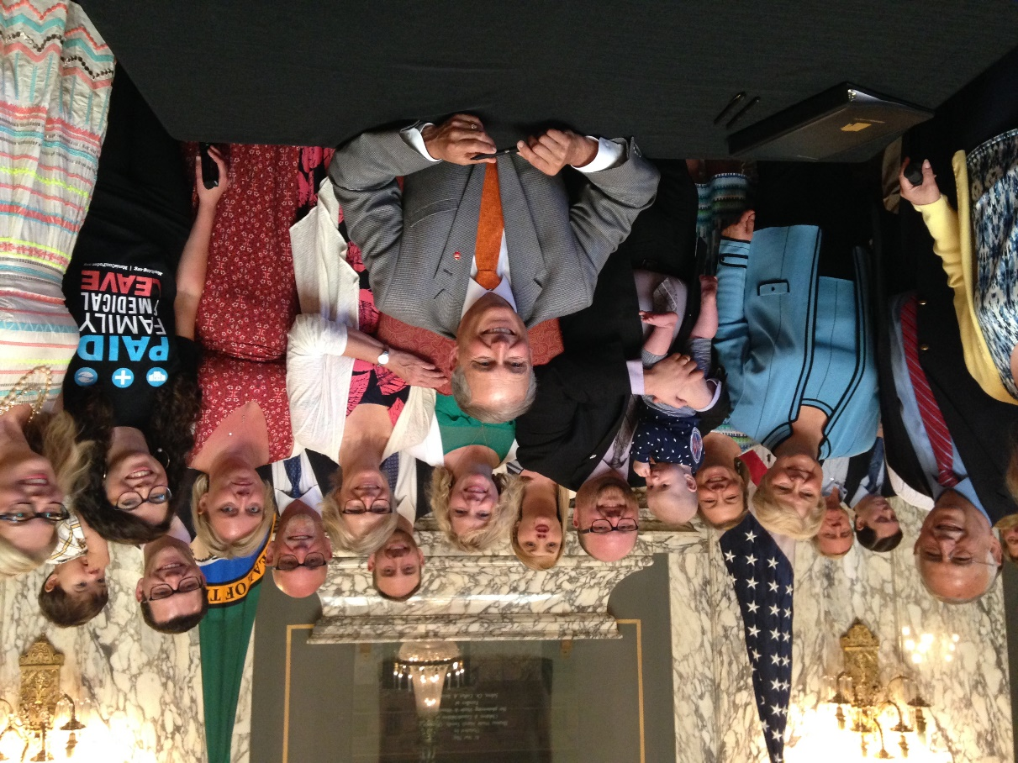


WA workers have won strong paid leave laws
opportunityinstitute.org

Slide 3
Overview of COVID-19 paid leave options
Also potentially available
Washington laws
Federal law, ends Dec. 31
Sick & Safe Leave: at least
1 hr for every 40 hrs worked
Sick Leave: 10 days for most COVID needs
Workers Comp: If contracted COVID-19 at work
Paid Family & Medical Leave: 12- 18 wks
FMLA expansion: 2 wks unpaid, 10 wks paid for childcare only
Unemployment Insurance: up to 39 wks
opportunityinstitute.org

Slide 4
Washington paid leave options
You are ill, caring for sick family member, seeking health care
You or a family member are seriously ill with COVID-19
Your work place or child's school or daycare is closed by public health order
WA PFML
You or a family member have any serious health condition
Existing paid sick days
You are caring for a new child or a family member is deployed overseas
Domestic violence, sexual assault, stalking
opportunityinstitute.org

Slide 5
Washington paid leave minimums
Paid Sick & Safe Leave
Paid Family & Medical Leave
At least 1 hr for every 40 hrs worked
Full pay via paycheck
Enforced by Dept. Labor & Industries, Seattle, Tacoma
C.b.a. or employer policy may provide additional
12 to 18 weeks
Eligibility: 820 hours work in past yr
Social insurance program
90% to 60% pay
Apply at paidleave.wa.gov
opportunityinstitute.org

Slide 6
Gov. Inslee’s emergency order:
In effect Apr 13-Jun 12
Workers defined as high-risk by CDC have rights to accommodations at work to prevent coronavirus infection, and where not feasible:
Use of employee’s choice of any accrued employer-provided leave or UI
Unpaid leave until safe to return to work
Continuation of health insurance
Protection from retaliation or permanent replacement
opportunityinstitute.org

Slide 7
Federal COVID-19 response paid leave
Covers all non-federal public sector; private employers with fewer than 500 U.S.-based employees
Employers of health care workers & emergency responders, or with fewer than 50 employees can request exclusion for all or some workers
You must have a job and have work available
Available April 1-Dec. 31, 2020 only
Paid by employers, who are reimbursed by IRS
Enforced by U.S. DOL
Federal COVID, ends Dec. 31
Sick Leave: 10 days for most COVID needs
FMLA expansion: 2 wks unpaid, 10 wks paid for childcare only
opportunityinstitute.org

Slide 8
Federal Emergency Paid Sick Time
You have been ordered or advised by health provider to self-quarantine
In addition to any other leave
10 days (80 hrs)
Prorated for part time
Full pay up to $511 per day for self
2/3 pay up to $200 per day for caring for someone else (may “top off”)
Your choice when to use
You have COVID-19 or are seeking diagnosis
Federal COVID-19 paid sick leave
You're caring for someone who is quarantined or may have COVID-19
You child's school or childcare is closed due to COVID-19
opportunityinstitute.org

Slide 9
Federal COVID-19 FMLA Expansion
1st 2 weeks unpaid (can use sick leave);
10 weeks paid
2/3 of usual wage up to $200 per day (total up to $10,000; may “top off” or supplement)
Eligibility: with employer 30+ days
Job protection in firms with 25+ employees
Employers may deduct any FMLA taken within last 12 months and restrict future FMLA
(no impact on WA PFML)
Federal COVID-19 paid family leave
Your child's school or daycare is closed due to coronavirus
opportunityinstitute.org

Slide 10
When to use which paid time off?
What can I use it for?
How much time off can I get?
How much will I get paid?
How soon will I get paid?
What might I need later on?
Washington laws
Federal COVID, ends Dec. 31
Sick & Safe Leave: at least 1 hr for every 40 hrs worked
Sick Leave: 10 days for most COVID needs
Paid Family & Medical Leave: 12- 18 wks
EFMLEA: 2 wks unpaid, 10 wks paid for childcare only
opportunityinstitute.org

Slide 11
For COVID-related, consider using federal leave first
You have been ordered or advised by health provider to self-quarantine
This leave expires Dec. 31
Full pay in regular paycheck for self
2/3 pay for caregiving. Hint: ask employer to top off or use PTO to supplement
You’ll still have all your employer paid leave and WA PFML for other needs
Check Workers’ Comp eligibility if you got COVID-19 at work: Lni.wa.gov
You have or are seeking diagnosis of COVID-19
Federal sick leave
You're caring for someone who is quarantined or may have COVID.
Child’s school or childcare closed – 2 wks
FMLA expansion
Child's school or childcare closed – 10 wks paid
opportunityinstitute.org

Slide 12
Consider using your regular sick leave or WA PFML:
For non-COVID-19 needs
For COVID-19 if your employer isn’t covered by federal emergency leave or excludes you from coverage
Consider for COVID if you have 100s of hours of sick leave accrued
Remember – due to high demand, WA PFML and Unemployment Insurance currently take several weeks to approve applications (but pay retroactively to beginning of eligibility)
PFML is also available between jobs or if you have no work, as long as you worked 820 hours last year; apply at paidleave.wa.gov
opportunityinstitute.org

Slide 13
Emergency expansions may make
Unemployment Insurance an option
Your employer has reduced your hours
Federal and state COVID-response expansions make UI available to many impacted documented workers
Between March 29 and July 25, UI recipients will receive $600/wk on top of usual benefits
Benefits are retroactive to date of eligibility and can extend for up to 39 weeks
See eligibility checker and apply at esd.wa.gov
You have been laid off or furloughed
Unemployment Insurance
You are a gig worker or self-employed and no longer have work
You were about to start a new job, but the job is no longer there
opportunityinstitute.org

Slide 14
FAQs: How do I apply for federal emergency paid leave?
Let your employer know in advance if possible
Provide your employer a written statement with:
    Your name, dates of requested leave, and reason you can’t work
    If under quarantine or isolation, the government entity that ordered or health care provider who advised
    If caring for child who’s school or childcare is closed, the names of the child and school/childcare, and a statement that no other suitable person is available to provide care
opportunityinstitute.org

Slide 15
FAQs: Are gig and self-employed workers covered?
  WA PFML: Gig, contract, and self-employed people may opt in at paidleave.wa.gov
  Federal COVID-19 paid sick leave and FMLA expansion: Gig, contract, and self-employed people may claim tax credits for both, and reduce their quarterly tax payments accordingly. See IRS.gov for details.
  Pandemic UI expansion: Gig, contract, self-employed people, and recent entrants to the workforce can receive Unemployment Insurance during emergency period at esd.wa.gov
opportunityinstitute.org

Slide 16
FAQs: Are immigrant workers covered?
For most paid leave options, yes:
  Immigrant workers are fully covered by Washington Paid Sick & Safe Leave and Paid Family & Medical Leave laws, regardless of status.
  Immigrant workers are entitled to federal emergency COVID-19 leave regardless of status.
  Use of paid leave does not count as “public charge.”
Undocumented workers cannot access UI or many other federal and state programs.
See FairWorkCenter.org or NWjustice.org for additional help.
opportunityinstitute.org

Slide 17
FAQs: Can my employer supplement pay under federal emergency paid leave?
If you take either the new federal COVID response paid sick leave or paid family leave to care for someone else, U.S. Dept. of Labor guidance says explicitly that employers may pay more than the required 2/3 of your usual pay (but your employer will not receive federal reimbursement for that extra amount).
You and your employer may also agree to use your regular PTO or sick leave to “top off” either federal benefit up to your usual wages.
While using the 10 weeks of FMLA expansion to care for your child whose school or childcare is closed, you have the right to choose to take other accrued employer-provided leave and receive full pay. Your employer may also require you to take other leave concurrently during this time, but if they do, must give you full pay.
opportunityinstitute.org

Slide 18
FAQs: Can I take leave intermittently?
Yes, you can take Washington’s sick leave an hour or two at a time, or in larger blocks. You can also take Washington PFML intermittently, with a minimum of 8 hours in a week.
Federal COVID paid leave can be taken intermittently with the employer’s consent:
  for any covered reason if you are working from home
  for child care only if you are working at a worksite (not for COVID illness or potential infection)
opportunityinstitute.org

Slide 19
Get more information on your rights
Esd.wa.gov/newsroom/covid-19
Paidleave.wa.gov
Lni.wa.gov
Seattle.gov
DOL.gov
Opportunityinstitute.org
opportunityinstitute.org

Slide 20
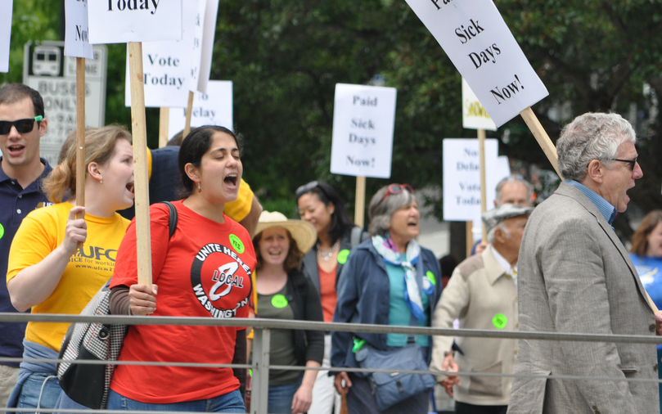

Keep fighting! Ask Congress and policymakers to:
Expand federal emergency leave to
cover all workers
Expand grants for child care and
small business recovery
Create permanent federal standards for paid sick & safe time and paid family & medical leave for all U.S. workers
Push for strong state and federal stimulus – NO to austerity and prolonged recession
Rebuild economy to promote equity, worker power, and working family resiliency
opportunityinstitute.org

